Slide 1
SIT mode-locking in QCLs
Petar Tzenov
Version 02
09.09.2016

Slide 2
EOM (equations of motion)
Gain section – Bloch equations
Absorber section - Bloch equations
Field

Slide 3
Normalization
Field

Slide 4
Normalization x2
Absorption section
Gain section

Slide 5
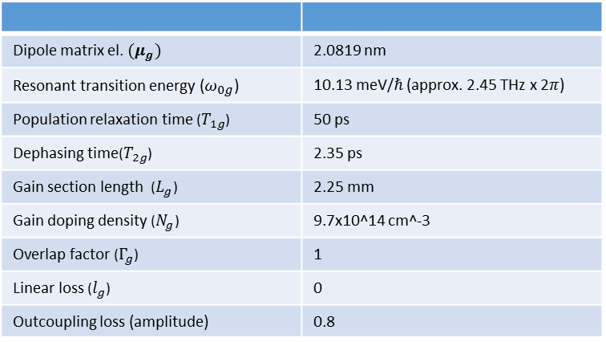
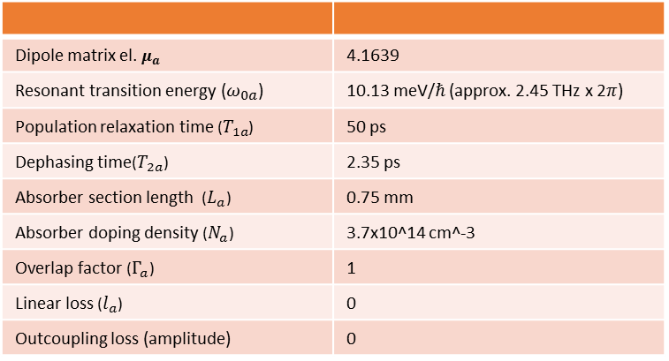
Gain section
Absorber section
Dipole matrix el. ${(μ}_{g})$ | 2.0819 nm
Resonant transition energy ($ω_{0g}$) | 10.13 meV/$ℏ$ (approx. 2.45 THz x 2$π$)
Population relaxation time ($T_{1g}$) | 50 ps
Dephasing time($T_{2g}$) | 2.35 ps
Gain section length ($L_{g}$) | 2.25 mm
Gain doping density ($N_{g}$) | 9.7x10^14 cm^-3
Overlap factor ($Γ_{g}$) | 1
Linear loss ($l_{g}$) | 0
Outcoupling loss (amplitude) | 0.8
Dipole matrix el. $μ_{a}$ | 4.1639
Resonant transition energy ($ω_{0a}$) | 10.13 meV/$ℏ$ (approx. 2.45 THz x 2$π$)
Population relaxation time ($T_{1a}$) | 50 ps
Dephasing time($T_{2a}$) | 2.35 ps
Absorber section length ($L_{a}$) | 0.75 mm
Absorber doping density ($N_{a}$) | 3.7x10^14 cm^-3
Overlap factor ($Γ_{a}$) | 1
Linear loss ($l_{a}$) | 0
Outcoupling loss (amplitude) | 0
Normalized EOM
With the normalization condition:
With the normalization condition:
With the normalization condition:

Slide 6
Results nthz = 1.0

Slide 7
Results nthz = 1.5

Slide 8
Results nthz = 2.0

Slide 9
Results nthz = 3.0

Slide 10
Results nthz = 3.6

